Slide 1

Agenda
Discussion on initial reputation calculation using Bayesian modelling & intuition behind threat score threshold values.
Implementation-level walkthrough of signature scanner module.
Discussion on DSCAN placement & hardware and setup requirements .

Slide 2
Discussion on initial reputation calculation using Bayesian modelling & intuition behind threat score threshold values

Slide 3


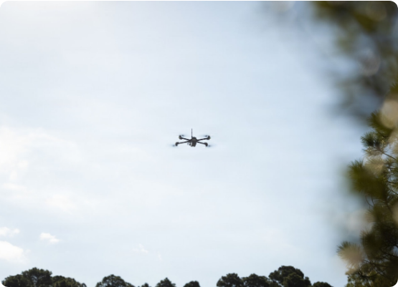

DRONE REPUTATION DYNAMICS
Intuition of Reputation (R)
Reputation is a metric ranging from 0 to 1 that quantifies source reliability.
•
R = 1: Fully Trusted. A highly reputable source with a clean history.
•
R = 0: Fully Untrusted. A malicious source identified by the system.
Feedback Mechanism
Reward: If transmitted data is non-malicious, R increases.
Penalty: If data is found to be infected, R decreases significantly.

Slide 4







The "Cold Start" Challenge
Unknown Origin
Security Risk
Contextual Strategy
When a drone enters the network for the first time, there is no historical data in the database to compute its reputation.
Assigning a static default reputation is dangerous. A malicious drone could exploit a high default score to bypass deep inspection.
We solve this by using Observable Contextual Features (Zone & File Type) to derive a principled prior reputation.

Slide 5


BAYESIAN CONTEXTUAL STRATEGY
Observable Features
Contextual Prior
Even for new drones, two critical attributes are always known at the ingestion point:
The model answers: "Given a file is from Zone Z and has File Type F, what is the probability it is benign?"
This provides a data-driven reputation for new drones without relying on history.
•
Zone (Z): The operational zone from which data originates.
•
File Type (F): The type of data (Video, ZIP, Image, etc.).

Slide 6
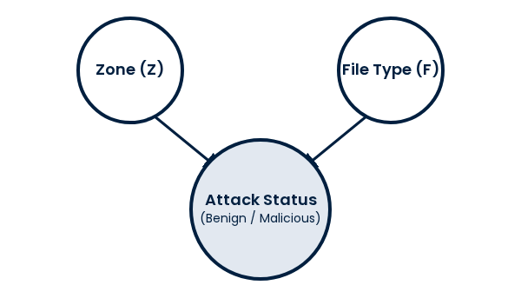
BAYESIAN BELIEF NETWORK (BBN)
Topology: Observable evidence (Zone & File Type) influences the probability of Attack Status.

Slide 7
BAYESIAN MATHEMATICAL FORMULATION
We compute the posterior probability P(N | Zone, File) to derive the reputation score R.
N: No Attack (Benign) | A: Attack (Malicious)

Slide 8
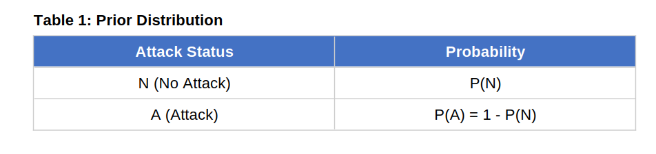
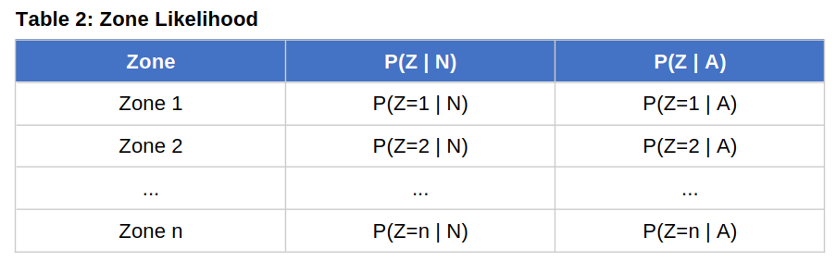
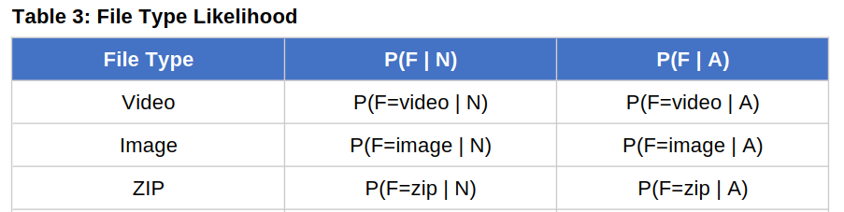
Conditional Probability Table (CPT)

Slide 9

EXAMPLE:
Metric | Benign (N) Probability | Attack (A) Probability
Prior Probability | P(N) = 0.85 | P(A) = 0.15
Zone 3 Likelihood | P(Zone=3 | N) = 0.12 | P(Zone=3 | A) = 0.35
ZIP File Likelihood | P(File=ZIP | N) = 0.08 | P(File=ZIP | A) = 0.45
Numerator: 0.85 × 0.12 × 0.08 = 0.00816
Denominator: 0.00816 + (0.15 × 0.35 × 0.45) = 0.03179

Slide 10
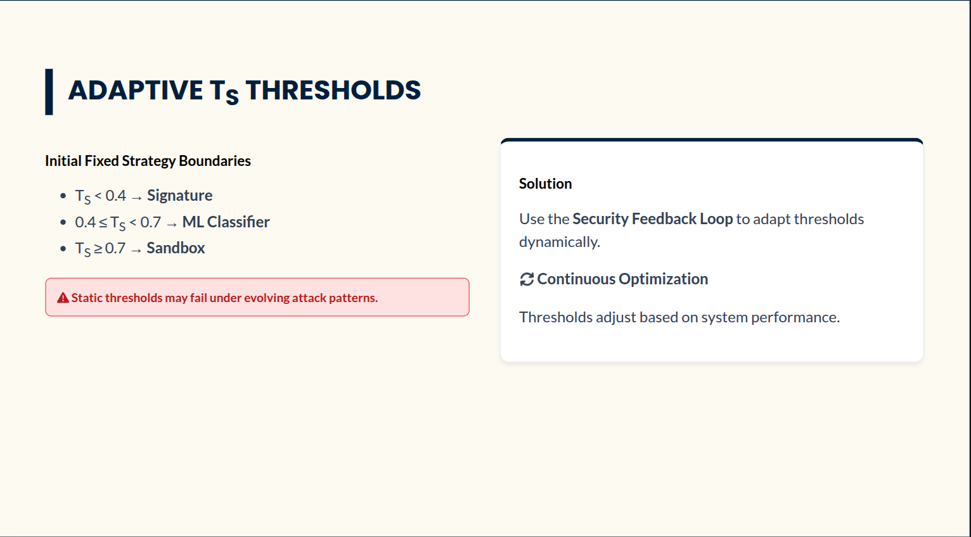

Slide 11
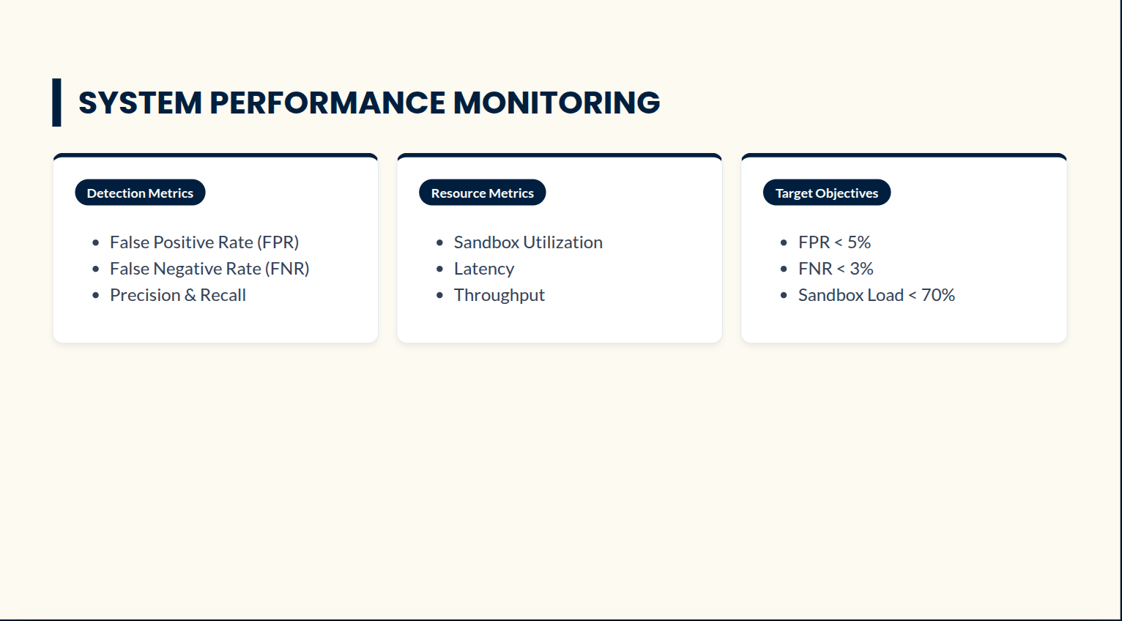
(These are just examples)

Slide 12
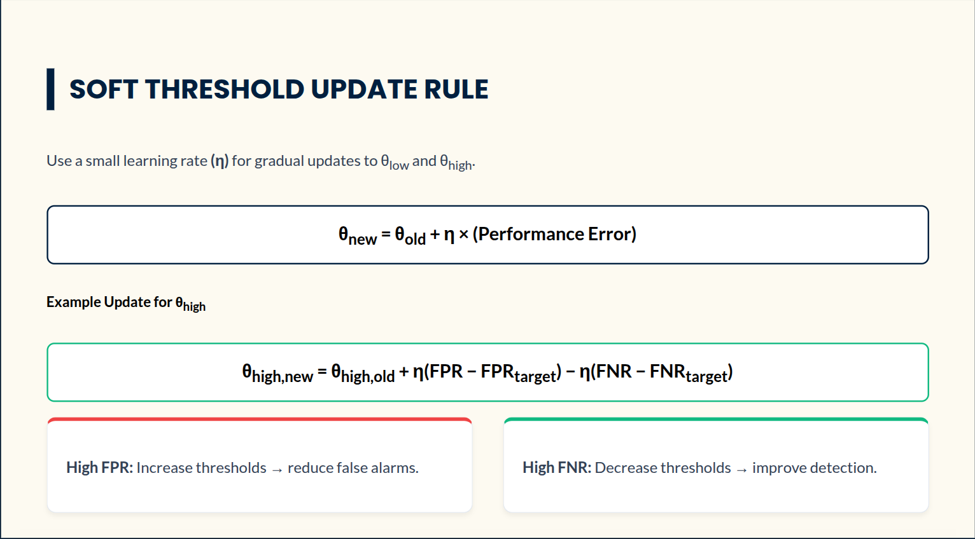

Slide 13
